Slide 1
Good morning.
Programming - WEC 2018

Slide 2
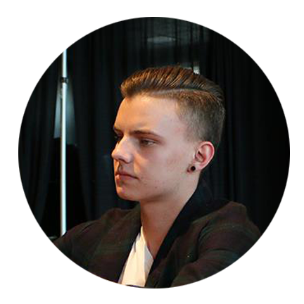



Meet the Developers
Paul
Mike
Maks
Taylor
Software Engineering Students

Slide 3
Problem Statement
“The project today is to build an application that will help manage your time and tasks to be more efficient in getting projects done. You will be working with your teams to create a program that manages tasks, task timer, notes and calendar”

Slide 4
Our Solution

Slide 5

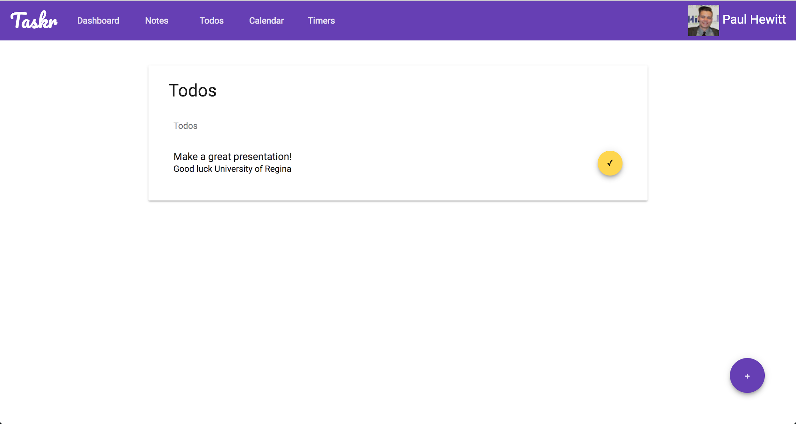
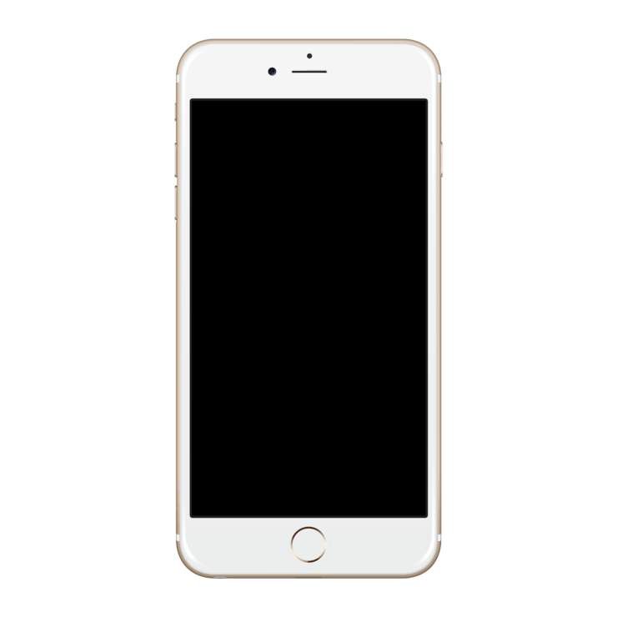
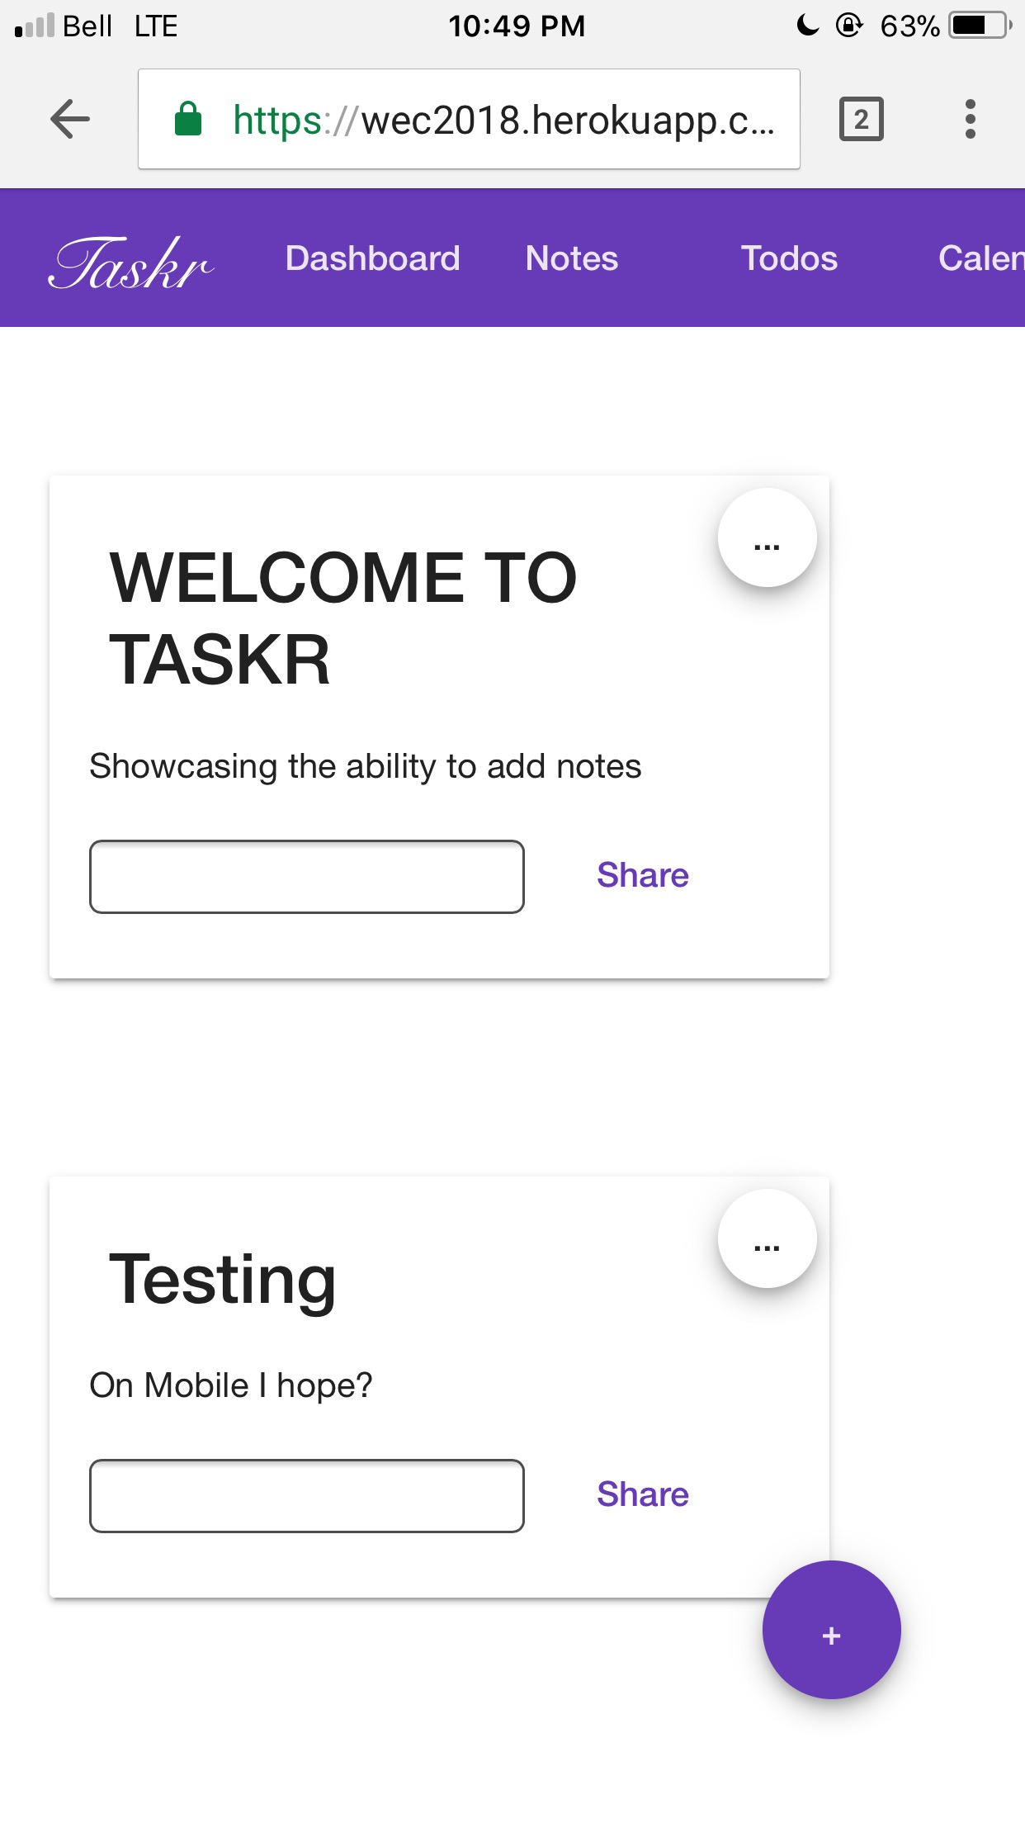
Taskr
Time, Tasks, To-dos

Slide 6
Taskr
-Focus on the five main categories
-Angular allows us to create reusable components
-Deploy a live app to cloud servers
-Google Login allows persistence, access your Taskr tools on any device
-Scalable, enterprise ready backend, with open API

Slide 7
Planning & Management

Slide 8
Planning & Management
Agile development: short sprints, regular team meetings
Used our “whiteboard” to design features before implementation
Every developer took on a role to maximize work
Pair programmed important features to reduce error
Developed RESTful API web service
Ensured scalable and enterprise ready practices were followed
Social media login for validation/persistence
Used GitHub for source control

Slide 9
Timeline
9:15 am
10:45 am
12:00 pm
2:00 pm
4:00 am
6:00 pm
8:45 am
Phase 1
Phase 2
Phase 3
Phase 4
Phase 5
Phase 6
Discuss and interpret problem
Spinning Up Application Skeleton
Google Auth, Database Design
Component Design, UI Design
User Persistence, Component Creation
Finalize Taskr, Test
Final Deploy
Notes:
Here is a quick overview of our time management, tried to check in every hour/two. Making a robust, scalable backend took up most of the time, and once that was developed things quickly began to fall together

Slide 10
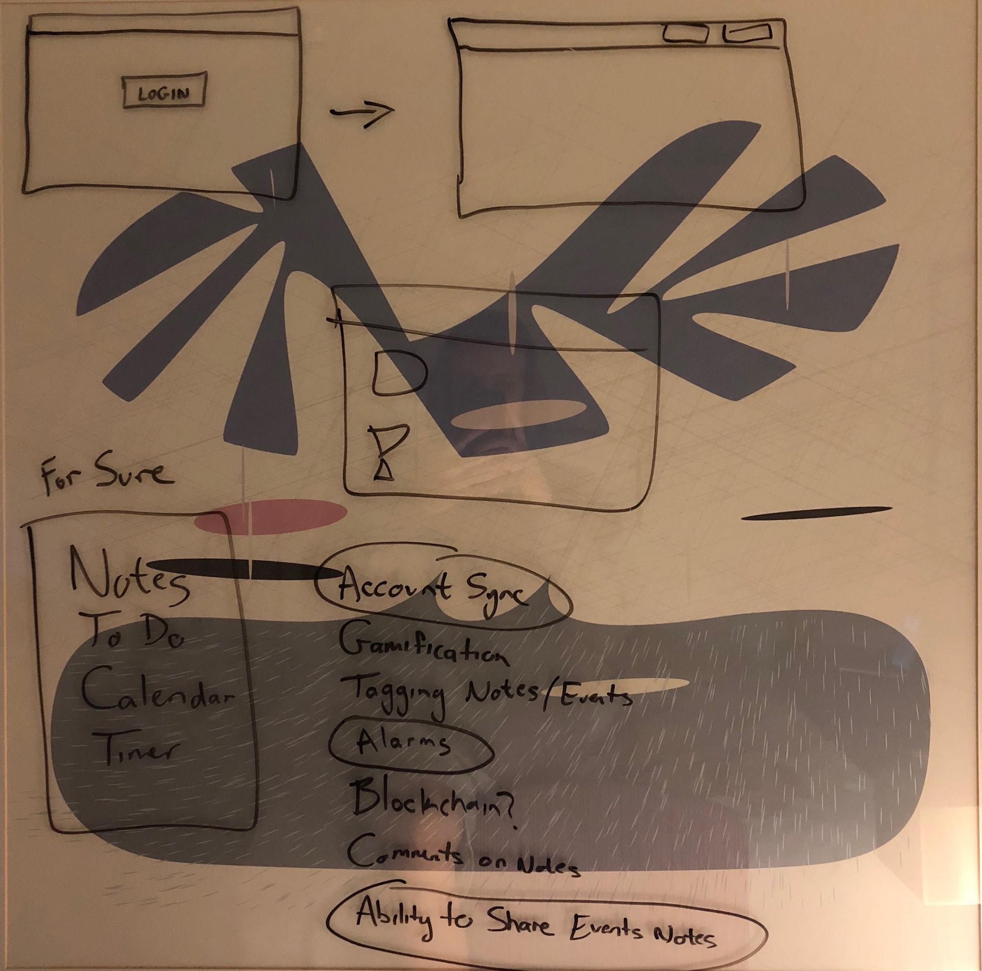
“The Whiteboard”

Slide 11
The Tech

Slide 12

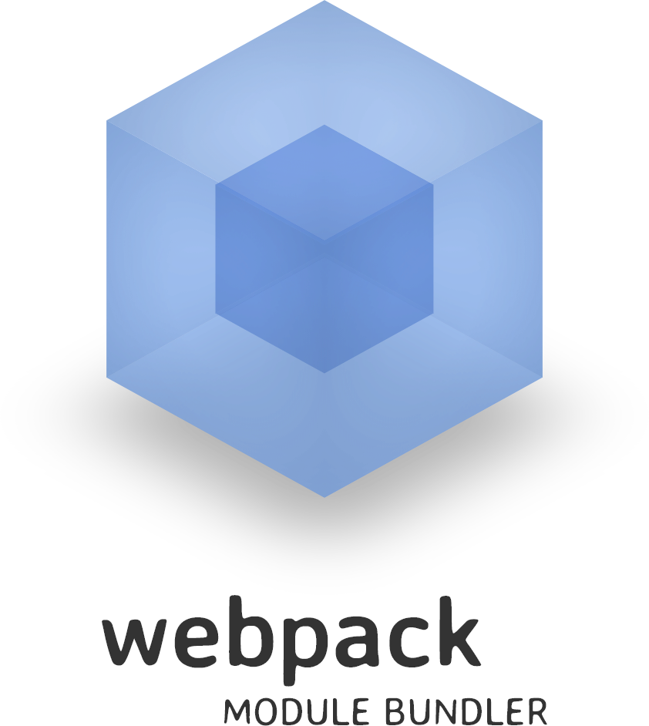



Tech Stack
-Angular5
-WebPack
-NodeJS
-MongoDB
-Bootstrap4
Enterprise Standard Frameworks
Notes:
We chose modern, innovative frameworks to build an extensible Performant solution which is ready to deploy, rather than a prebuilt web pack or something hacked together
Angular5: is a brand new tech and we were super excited to use as it is such a modular innovative solution
webPack is module builder
NodeJs is a Javascript server runtime environment
MongoDB is a NoSQL database
Bootstrap4 is the newest bootstrap styling solution.

Slide 13

Google Integration
Taskr utilizes Google OAuth login
Access to Google’s wide variety of integrated features
Persist user’s data across browser sessions and devices
Login provides validation and removes necessity for account setup
Users can login to Taskr using a familiar username/password
Notes:
Taskr utilizes googles 0Auth login for a secure and personalized login
Along with this we have quick and easy access to a wide variety of integrated features to supplement our own apps functionality
By associating our own used model with google account we can persist user data based on login across application and session
Login provides validation and removes necessity for account setup - skip the setup and keep the functionality easy choice
further this allows taskr to feel familiar by using associating this with your google credentials

Slide 14
UML & Architecture

Slide 15
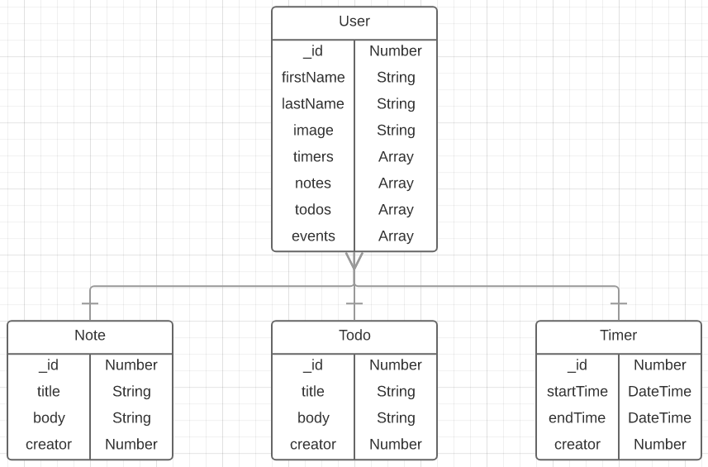
Data
Model
Notes:
Mongodb non relational database
Designed models to share between backend and frontend
User owns lists of different objects
Creator is the user’s id

Slide 16
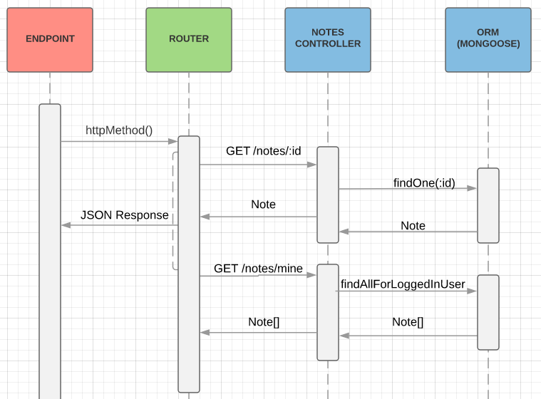
Backend
Sequence
Diagram
Notes:
Frontend/client can consume JSON response

Slide 17
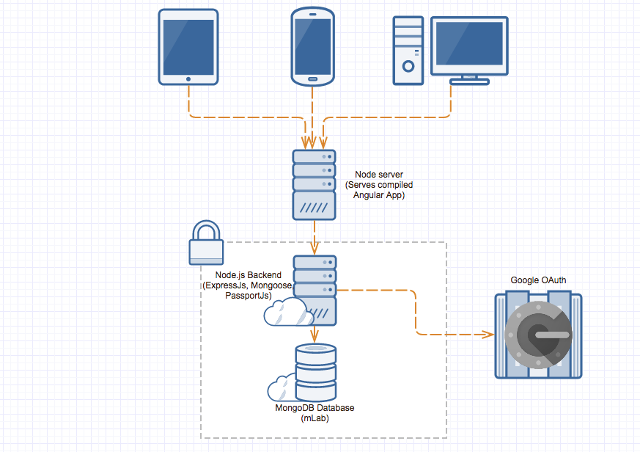
Network
Application
Architecture

Slide 18
Features

Slide 19
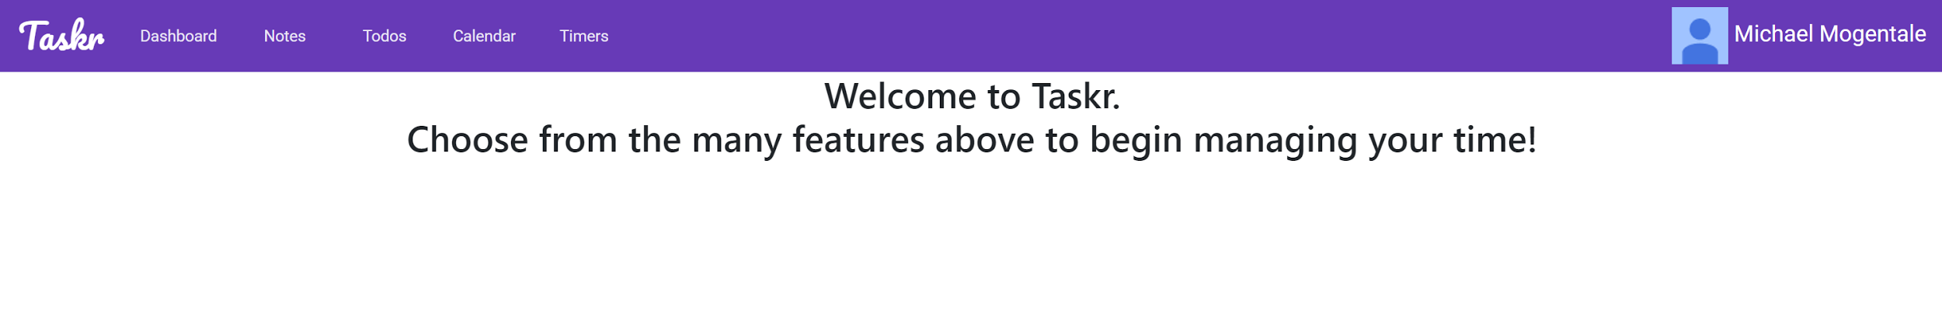
Dashboard
Used to display the navigation bar routes to easily access all of the pages
Once signed in users name and photo are displayed

Slide 20
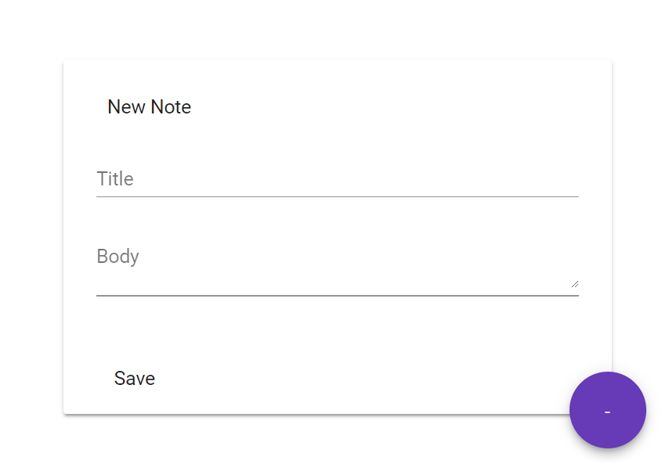
Notes
Quick information widget used to write down ideas for later
Notes can be shared with other users via user id
Fill screen with notes in order of generation
Allows messages to be exchanged

Slide 21
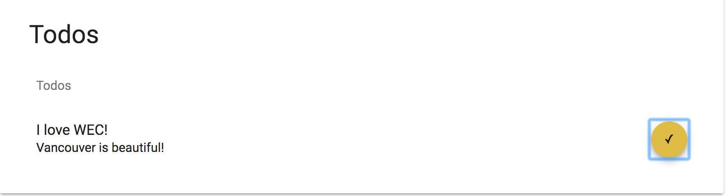
To-do List
Ability to add tasks to a dynamic list
Mark a task finished using a checkmark and remove it

Slide 22
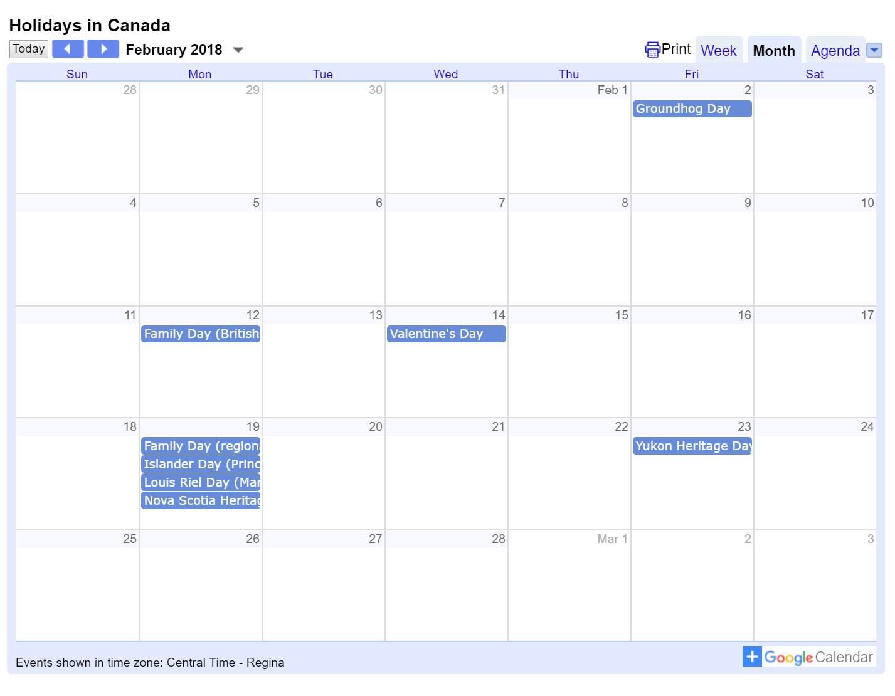
Calendar
Embedded Google Calendar component to show events for the week

Slide 23
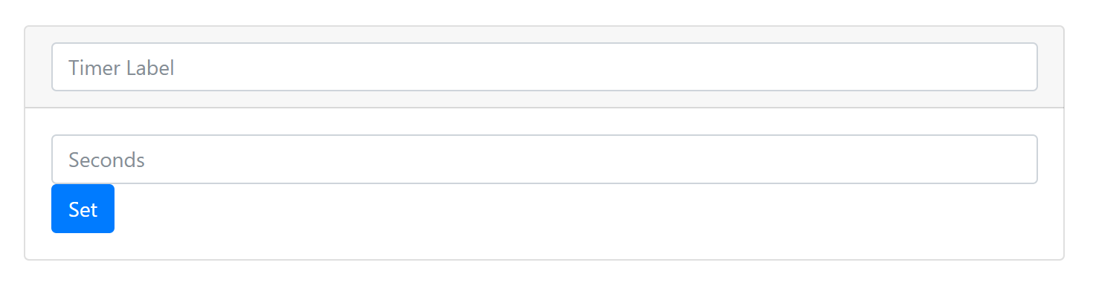
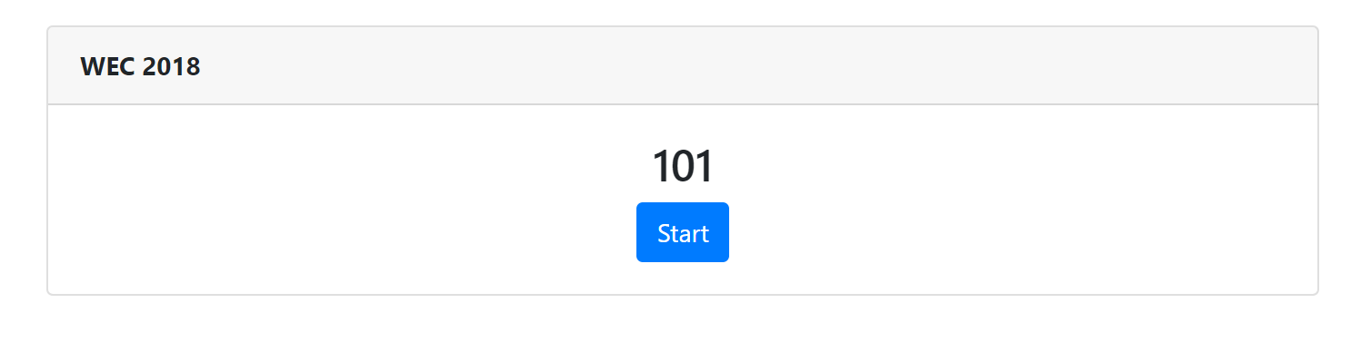
Timer
Set a countdown timer in seconds
Allows a label and time to be set, and then counted down
The user will receive an alert upon time completion

Slide 24
Demo

Slide 25
Next Steps
-Storing items on a Blockchain
-Customizable dashboard
-Deeper Google Calendar integration
-Gamification
-Exporting notes, todos, etc

Slide 26
Trivia
Commits to Frontend: 88
Commits to Backend: 15
Lines of Code: Lots
Merge Conflicts: 1
Sandwiches Consumed: 8

Slide 27

Questions?

